Slide 1
Production Systems

Slide 2
Fundamentals
Semantic Networks
Generate and Test
Production Systems
Means-Ends Analysis
Problem Reduction

Slide 3
Lesson Preview
Cognitive architectures
Production systems
Chunking

Slide 4
It’s the top of the 7th inning. There are runners on 2nd and 3rd base. There are two outs. The batter, Martin Prado, has an average of .256 and bats fourth in the batting order. We are winning 3-2. I struck this batter out last time. My goal is to escape the inning.
What should the pitcher do?
ο Pitch to the batter
ο Intentionally walk the batter

Slide 5
Cognitive System
Metacognition
Deliberation
Reasoning
Input
Output
Learning
Memory
Reaction

Slide 6
Cognitive System
Metacognition
Deliberation
Reasoning
Input
Output
Learning
Memory
Reaction

Slide 7
High Level
Task / Knowledge Level
(e.g. selecting a pitch, playing baseball)
architecture for
content for
Algorithm / Symbol Level
(e.g. means-ends analysis, semantic networks)
architecture for
content for
Hardware / Implementation Level
(e.g. a brain, a transistor)
Low Level

Slide 8
What are the layers of Watson?
the physical computer
searching and decision-making
answering the inputted clue

Slide 9
Assumptions of a Cognitive Architecture
Goal-oriented
Rich, complex environment
Significant knowledge
Symbols and abstractions
Flexible and function of the environment
Learning

Slide 10
Architecture
+
Content
=
Behavior

Slide 11
Function for cognitive architectures:
f: P* → A
Percepts → Action

Slide 12
Cognitive System
Metacognition
SOAR
Deliberation
Reasoning
Input
Output
Learning
Memory
Reaction

Slide 13
Cognitive System
Metacognition
SOAR
Procedural
Semantic
Episodic
Input
Output
Working Memory
Reaction

Slide 14
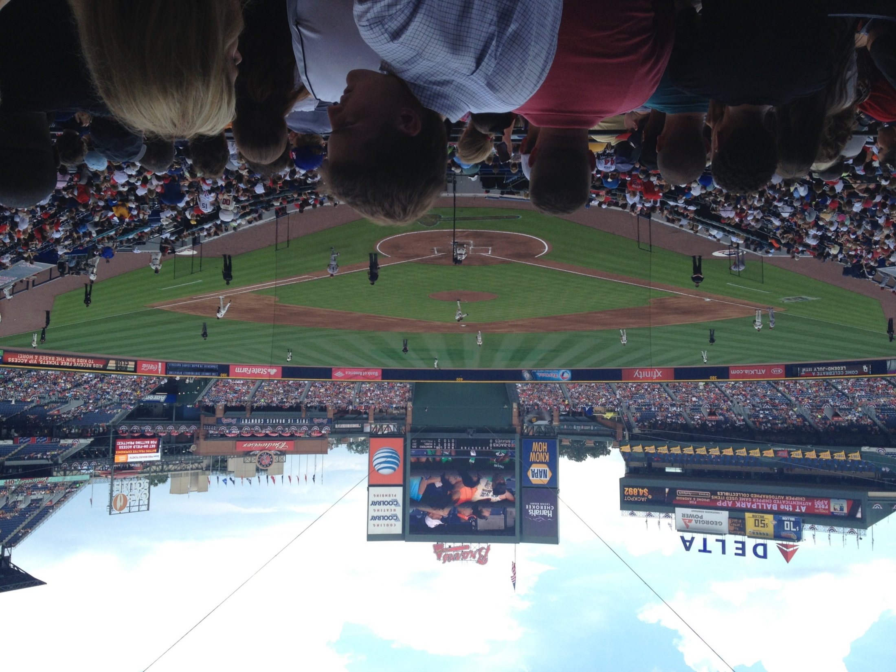
pitcher: P* → A

Slide 15
It’s the top of the 7th inning. There are runners on 2nd and 3rd base. There are two outs. The batter, Martin Prado, has an average of .256 and bats fourth in the batting order. We are winning 3-2. I struck this batter out last time. My goal is to escape the inning.
What should the pitcher do?
ο Pitch to the batter
ο Intentionally walk the batter

Slide 21
He chooses a curve ball …
He chooses a fast ball …
Strike …
He chooses a slider
Ball …
Hit …
Kris Medlen is pitching
Martin Prado is at bat
Kris Medlen’s goal is to finish the inning without allowing any runs
He chooses to pitch
Out …
He chooses to walk
He faces the next batter …

Slide 22
S₄
f1 : v3
f2 : v6
S₉
f1 : v2
f2 : v3
S₁₀₀
f1 : v9
f2 : v9
S₁
f1 : v1
f2 : v1
S₇
f1 : v8
f2 : v7
S₁₂
f1 : v7
f2 : v6
S₀
f1 : v1
f2 : v2
S₅
f1 : v3
f2 : v5
S₁₀
f1 : v5
f2 : v5
S₁₀₁
f1 : v1
f2 : v5
S₃
f1 : v1
f2 : v3
S₈
f1 : v9
f2 : v1
S₁₃
f1 : v6
f2 : v7
S₆
f1 : v3
f2 : v4
S₁₁
f1 : v5
f2 : v4
S₁₀₂
f1 : v5
f2 : v1

Slide 23
It’s the top of the 7th inning. There are runners on 2nd and 3rd base. There are two outs. The batter, Martin Prado, has an average of .256 and bats fourth in the batting order. We are winning 3-2. I struck this batter out last time. My goal is to escape the inning.
inning : 7th
portion : top
runners : 2nd and 3rd
outs : 2
batter : Prado
average : .287
bats : right-handed
score : 3-2
goal : escape inning

Slide 24
Cognitive System
Metacognition
SOAR
Procedural
Semantic
Episodic
Input
Output
Working Memory
inning : 7th
portion : top
runners : 2nd and 3rd
outs : 2
batter : Prado
average : .256
bats : right-handed
score : 3-2
goal : escape inning
Reaction

Slide 25
(r1) If goal is to Escape, I perceive 2 outs, I perceive a runner on 2nd and I perceive no runner on 1st
then suggest goal intentionally walk batter (Intentional Walk)
(r2) If goal is to Escape, I perceive fewer than 2 outs, or I perceive a runner on 1st, or I perceive no runner on 2nd, or I perceive no runners
then suggest goal to get the batter out via pitching (Pitch)
(r3) If goal is Intentional Walk
then suggest intentional-walk operator
(r4) If goal is Pitch and I perceive a new batter who is left/right-handed
then add batter not out, balls 0, strikes 0, bats left/right
(r5) If the goal is Pitch and batter not out
then suggest throw-curve-ball operator
(r6) If the goal is Pitch and batter not out and bats left-handed
then suggest throw-fast-ball operator
(r7) If only one operator has been selected
then send operator to the motor system and add pitch thrown to state
... ... ...
inning : 7th
portion : top
runners : 2nd and 3rd
outs : 2
batter : Prado
average : .256
bats : right-handed
score : 3-2
goal : escape inning

Slide 26
(r1) If goal is to Escape, I perceive 2 outs, I perceive a runner on 2nd and I perceive no runner on 1st
then suggest goal intentionally walk batter (Intentional Walk)
(r2) If goal is to Escape, I perceive fewer than 2 outs, or I perceive a runner on 1st, or I perceive no runner on 2nd, or I perceive no runners
then suggest goal to get the batter out via pitching (Pitch)
(r3) If goal is Intentional Walk
then suggest intentional-walk operator
(r4) If goal is Pitch and I perceive a new batter who is left/right-handed
then add batter not out, balls 0, strikes 0, bats left/right
(r5) If the goal is Pitch and batter not out
then suggest throw-curve-ball operator
(r6) If the goal is Pitch and batter not out and bats left-handed
then suggest throw-fast-ball operator
(r7) If only one operator has been selected
then send operator to the motor system and add pitch thrown to state
... ... ...
inning : 7th
portion : top
runners : 2nd and 3rd
outs : 2
batter : Prado
average : .256
bats : right-handed
score : 3-2
goal : escape inning
What operator is selected?
ο intentional-walk
ο throw-curve-ball
ο throw-fast-ball
ο None, the system cannot decide.

Slide 27
(r1) If goal is to Escape, I perceive 2 outs, I perceive a runner on 2nd and I perceive no runner on 1st
then suggest goal intentionally walk batter (Intentional Walk)
(r2) If goal is to Escape, I perceive fewer than 2 outs, or I perceive a runner on 1st, or I perceive no runner on 2nd, or I perceive no runners
then suggest goal to get the batter out via pitching (Pitch)
(r3) If goal is Intentional Walk
then suggest intentional-walk operator
(r4) If goal is Pitch and I perceive a new batter who is left/right-handed
then add batter not out, balls 0, strikes 0, bats left/right
(r5) If the goal is Pitch and batter not out
then suggest throw-curve-ball operator
(r6) If the goal is Pitch and batter not out and bats left-handed
then suggest throw-fast-ball operator
(r7) If only one operator has been selected
then send operator to the motor system and add pitch thrown to state
... ... ...
inning : 7th
portion : top
runners : 1st, 2nd, 3rd
outs : 2
batter : Hill
average : .269
bats : right-handed
score : 3-2
goal : escape inning
What operator is selected?
ο intentional-walk
ο throw-curve-ball
ο throw-fast-ball
ο None, the system cannot decide.

Slide 28
(r1) If goal is to Escape, I perceive 2 outs, I perceive a runner on 2nd and I perceive no runner on 1st
then suggest goal intentionally walk batter (Intentional Walk)
(r2) If goal is to Escape, I perceive fewer than 2 outs, or I perceive a runner on 1st, or I perceive no runner on 2nd, or I perceive no runners
then suggest goal to get the batter out via pitching (Pitch)
(r3) If goal is Intentional Walk
then suggest intentional-walk operator
(r4) If goal is Pitch and I perceive a new batter who is left/right-handed
then add batter not out, balls 0, strikes 0, bats left/right
(r5) If the goal is Pitch and batter not out
then suggest throw-curve-ball operator
(r6) If the goal is Pitch and batter not out and bats left-handed
then suggest throw-fast-ball operator
(r7) If only one operator has been selected
then send operator to the motor system and add pitch thrown to state
... ... ...
inning : 7th
portion : top
runners : 1st, 2nd, 3rd
outs : 2
batter : Parra
average : .273
bats : left-handed
score : 3-2
goal : escape inning
What operator is selected?
ο intentional-walk
ο throw-curve-ball
ο throw-fast-ball
ο None, the system cannot decide.

Slide 29
Cognitive System
Metacognition
SOAR
Procedural
Semantic
Episodic
Input
Output
Working Memory
inning : 7th
portion : top
runners : 1st, 2nd, 3rd
outs : 2
batter : Parra
average : .273
bats : left-handed
score : 3-2
goal : escape inning
Reaction

Slide 30
inning : 5th
portion : bottom
game : 131
weather : windy
runners : 1st, 3rd
outs : 1
batter : Pierzynski
average : .283
bats : left-handed
score : 1-4
goal : pitch
pitch : throw-fast-ball
result : homerun

Slide 31
(r8) If two operators selected and one has an episode with result homerun
then prefer other operator
inning : 5th
portion : bottom
game : 131
weather : windy
runners : 1st, 3rd
outs : 1
batter : Pierzynski
average : .283
bats : left-handed
score : 1-4
goal : pitch
pitch : throw-fast-ball
result : homerun
“chunking”

Slide 32
(r1) If goal is to Escape, I perceive 2 outs, I perceive a runner on 2nd and I perceive no runner on 1st
then suggest goal intentionally walk batter (Intentional Walk)
(r2) If goal is to Escape, I perceive fewer than 2 outs, or I perceive a runner on 1st, or I perceive no runner on 2nd, or I perceive no runners
then suggest goal to get the batter out via pitching (Pitch)
(r3) If goal is Intentional Walk
then suggest intentional-walk operator
(r4) If goal is Pitch and I perceive a new batter who is left/right-handed
then add batter not out, balls 0, strikes 0, bats left/right
(r5) If the goal is Pitch and batter not out
then suggest throw-curve-ball operator
(r6) If the goal is Pitch and batter not out and bats left-handed
then suggest throw-fast-ball operator
(r7) If only one operator has been selected
then send operator to the motor system and add pitch thrown to state
(r8) If two operators selected and one has an episode with result homerun
then prefer other operator
inning : 7th
portion : top
runners : 1st, 2nd, 3rd
outs : 2
batter : Parra
average : .273
bats : left-handed
score : 3-2
goal : escape inning
What operator is selected?
ο intentional-walk
ο throw-curve-ball
ο throw-fast-ball
ο None, the system cannot decide.

Slide 33
Assignment
How would you use a production system to design an agent that could answer Raven’s Progressive Matrices?

Slide 34
To recap…
Cognitive architectures
Production systems
Action selection
Chunking

